Slide 1
DIViDE AND CONQUER

Slide 2
GENERAL METHOD
The divide – and conquer strategy will compute a problem with n inputs by splitting the inputs into k distinct subsets,1<k<=n ,yielding k sub problems.
These sub problems are solved
A method will combine sub solution into solution of the whole.
Can reapply Divide – And – Conquer strategy if sub problems are relatively large.
        (Cont…)

Slide 3
Often sub problems resulting from DAndC strategy are of same type as original problem.
For those case we can reapply DAndC recurssively.
Then the larger prblms are divided into smaller and smaller prblms of the same kind until they are small enough to be solved without splitting.
Cont…

Slide 4
Algorithm
Control abstraction for
DIVIDE AND CONQUER strategy

Slide 5
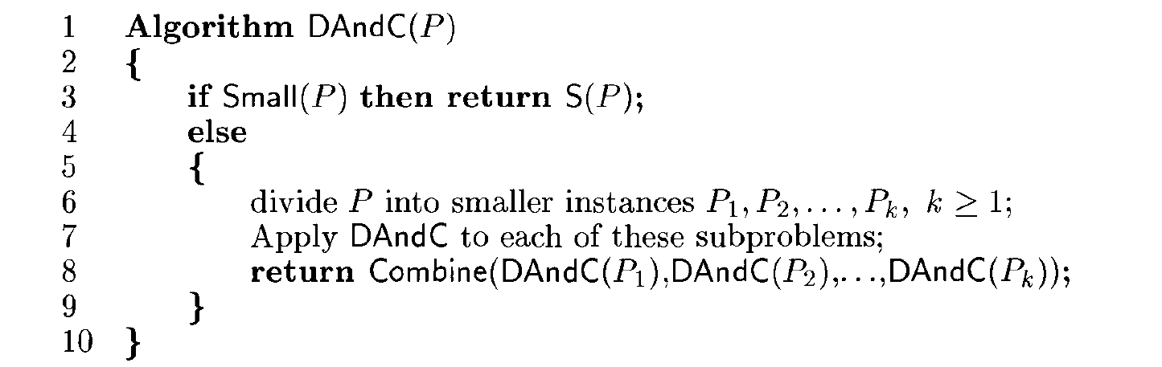

Slide 6
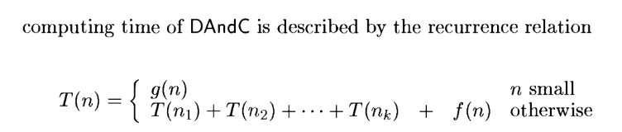
Where
T(n) - is the time for DAndC on any input of size n
g(n)- is the time to compute the answer directly for small inputs.
The function f(n) is the time for dividing P and combining the solutions to subproblems.

Slide 7
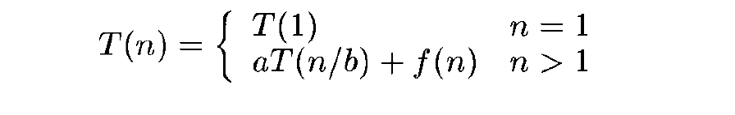
Computing the time of DAndC where T(n) – Time for DAndC on any input of size n. f(n) - time for dividing and combining solutions to subproblems.
Where a and b are known constants.

Slide 8


Binary Search Algorithm

Slide 9
What is Binary Search Algorithm?
Used to search an element from sorted array
To use binary search on an array, it must first be sorted because the approach only operates on sorted arrays.
As the number of iterations in the binary search reduces, it is a searching approach that is superior to the liner search technique.

Slide 10
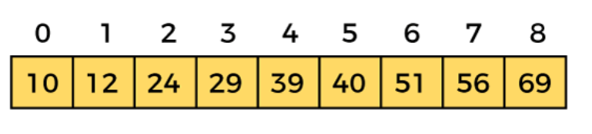
Consider the sorted array, A.
Let the element to search is, K = 56

Slide 11
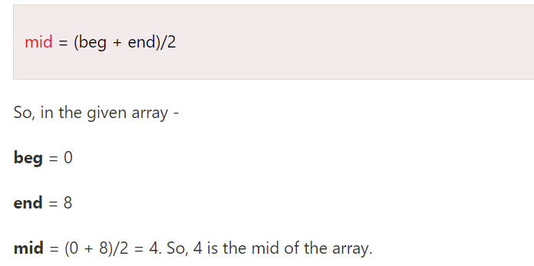

Slide 12
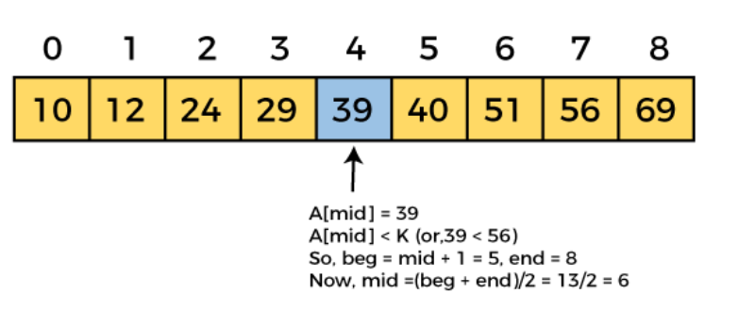

Slide 13
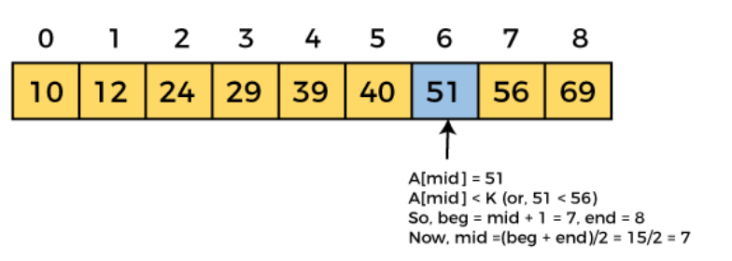

Slide 14
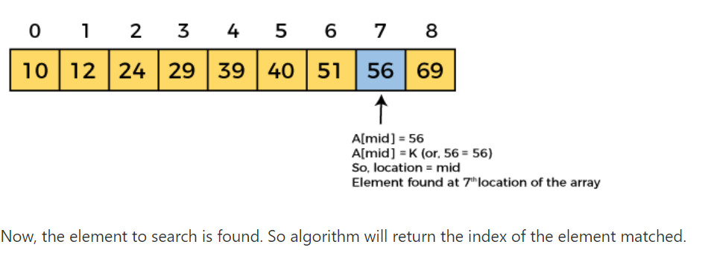

Slide 15
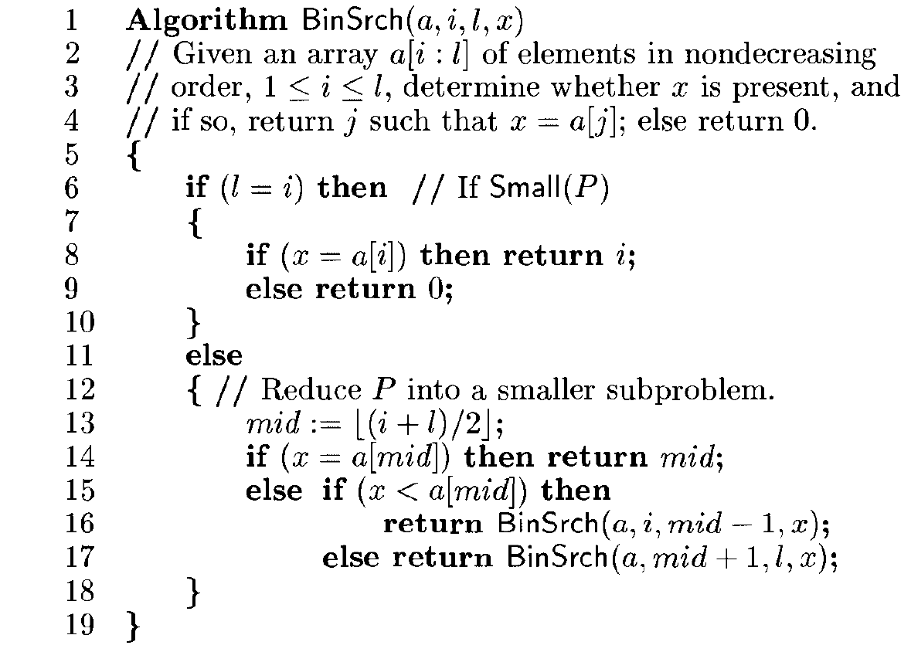

Slide 16
Searching problem can be denoted as P(n,i,l,x) where n is number of elements in the list, I,j are starting and ending indices of array a, x is the element to be searched.
Divide – and-conquer can be used to solve this problem.
Let Small(P) is true if n=1.In this case S(P) will take value i if x=a_{i} ,otherwise it will be zero.
Running time complexity when n=1,g(1)= Θ(1)

Slide 17
Cont..
If P has more than one element,can be divided into subproblems
Pick index q in range[i,l] compare x with a[q]
3 possibilities
x= a[q];can solve immediately
x<a[q];x need to search only in sublist a[i] to a[q-1]
x>a[q]; x need to search only in sublist to a[q+1] to a[l]

Slide 18

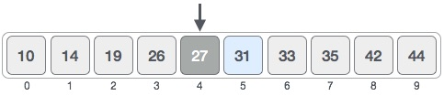
Example:binary search - x= 31

Slide 19

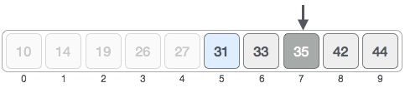

Slide 20

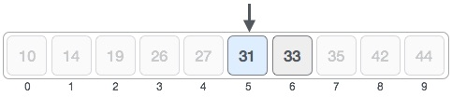


Slide 21
